Slide 1

RESUME PROJECT CHALLENGE Codex Energy Drinks Consumer Insights Dashboard
A project based on a 10,000-respondent survey
Moulika Kolavasi
Tools – SQL | Power BI
20/06/2025

Slide 2



ABOUT
INTRODUCTION
CodeX is a German energy drink brand expanding into India, with launches in 10 major cities. Known for focus-boosting and performance-enhancing drinks, CodeX aims to become a go-to choice for urban youth and professionals.
OBJECTIVE
To understand:
What Indian consumers think, prefer, and expect
How to market better and develop smarter
Where CodeX can grow and improve its brand presence

Slide 3
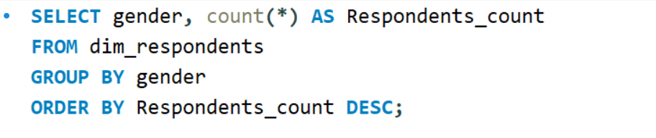
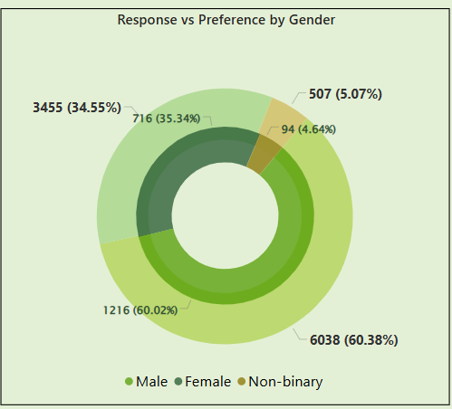
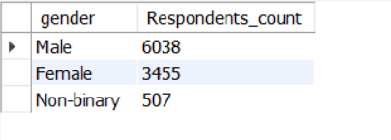
Who prefers the energy drink more? (male/female/non-binary?)
QUERY
OUTPUT
VISUAL

Slide 4
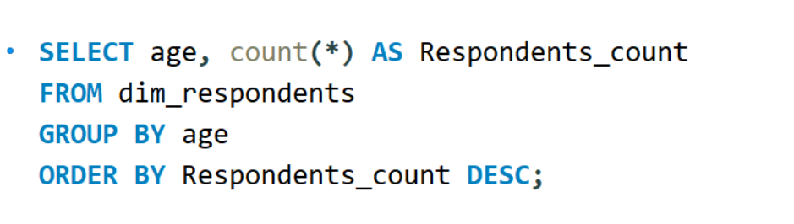
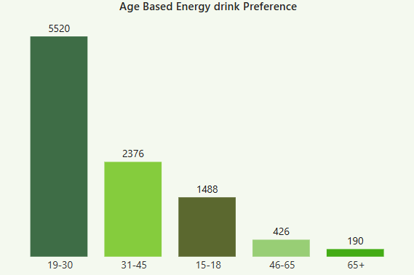
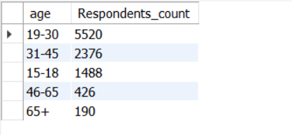
Which age group prefers energy drinks more?
QUERY
OUTPUT
VISUAL

Slide 5
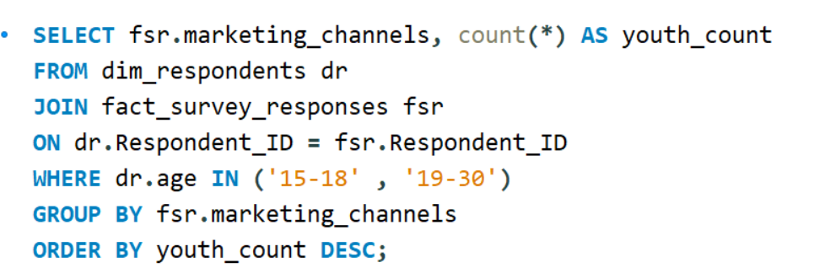
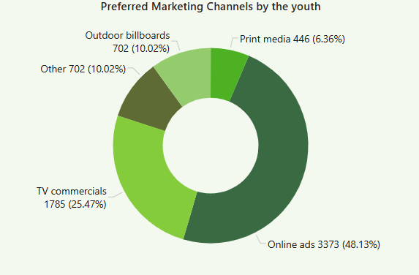
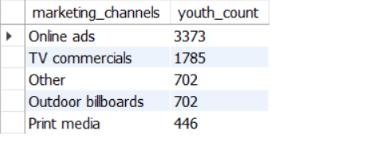
Which type of marketing reaches the most Youth (15-30)?
QUERY
OUTPUT
VISUAL

Slide 6
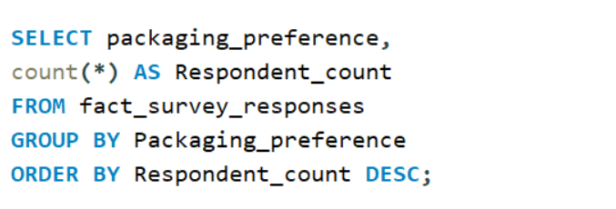
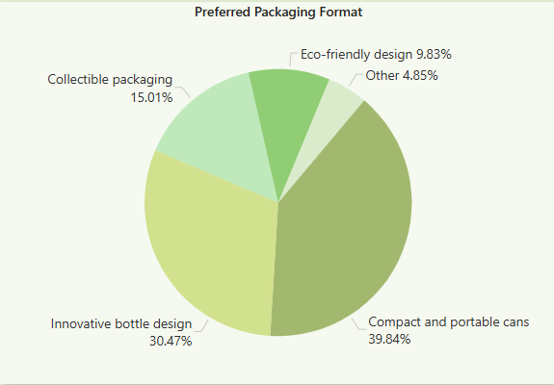
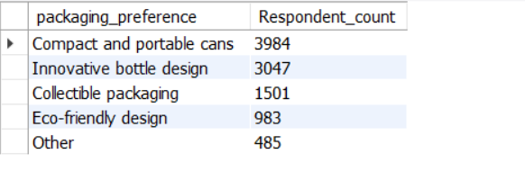
What packaging preferences do respondents have for energy drinks?
QUERY
OUTPUT
VISUAL

Slide 7
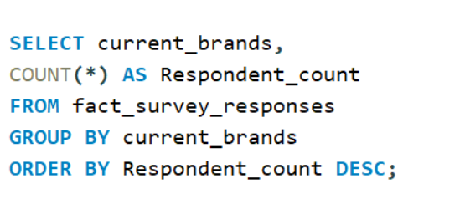
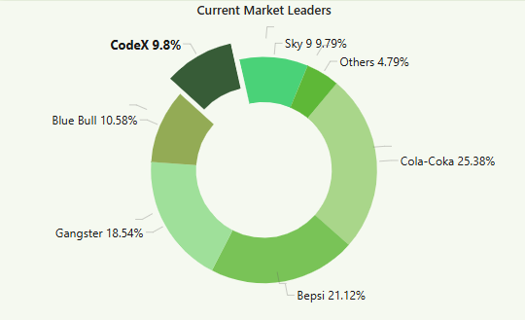
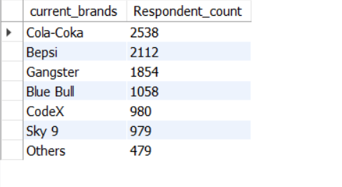
Who are the current market leaders?
QUERY
OUTPUT
VISUAL

Slide 8
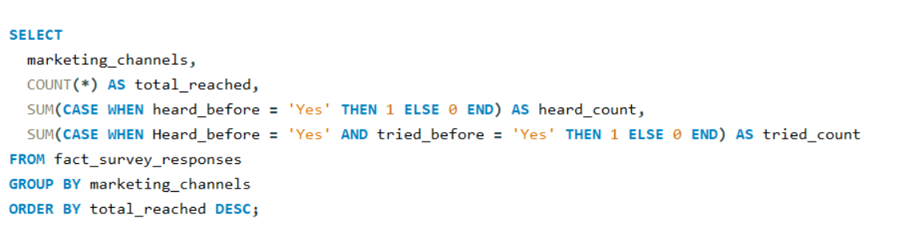
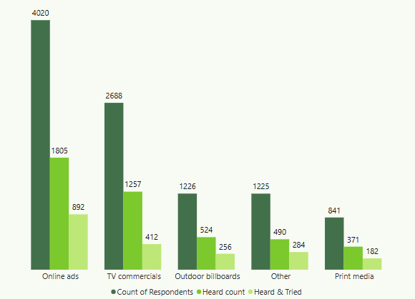
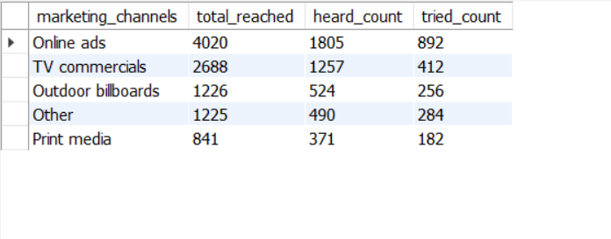
How effective are different marketing strategies and channels in reaching our customers?
QUERY
OUTPUT
VISUAL

Slide 9
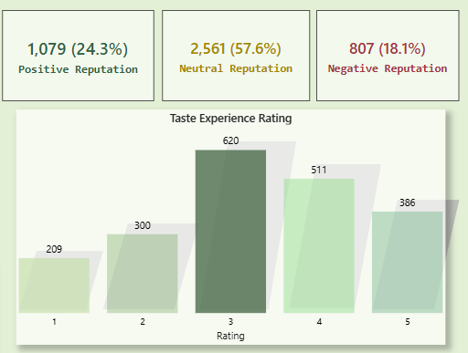
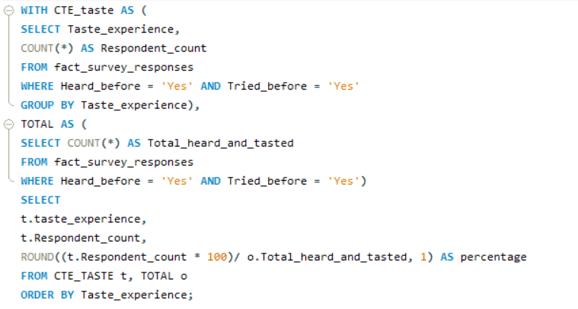
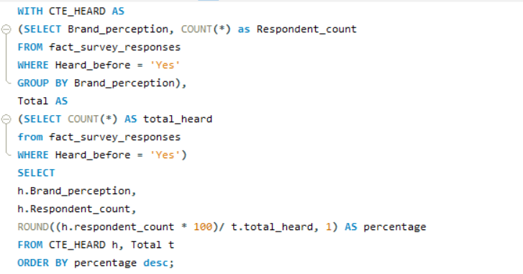
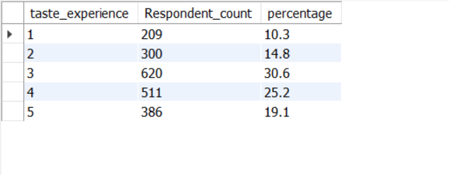
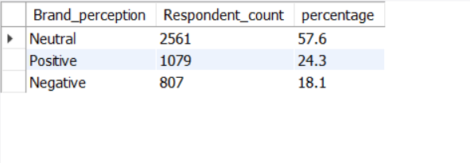
What do people think about our brand? (overall rating)
QUERY
OUTPUT
VISUAL

Slide 10
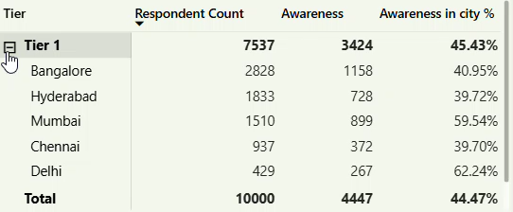
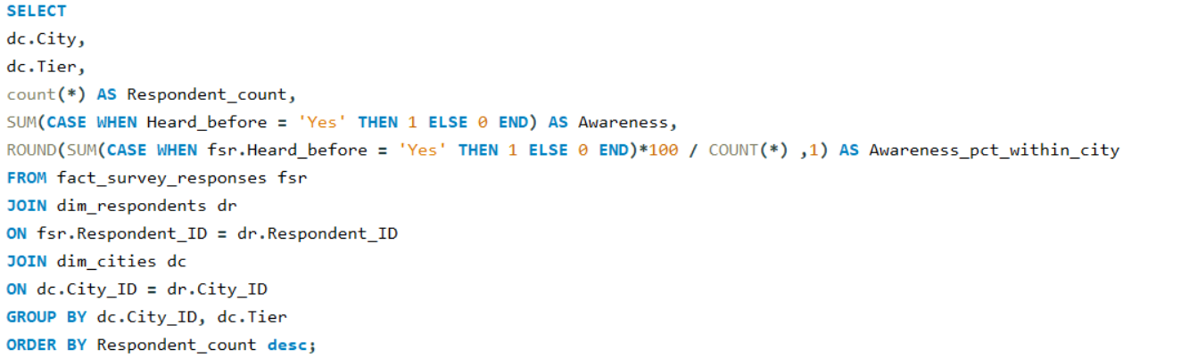
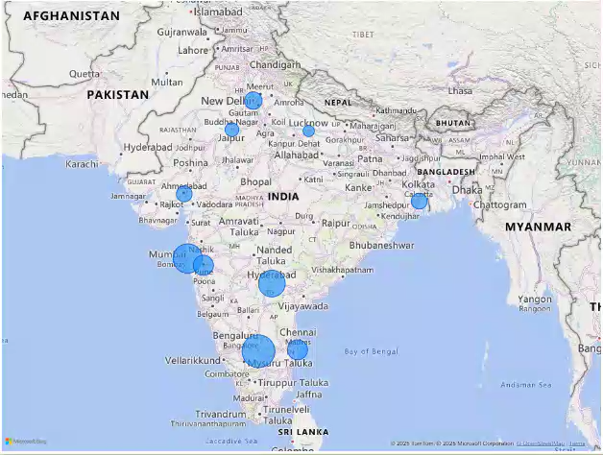
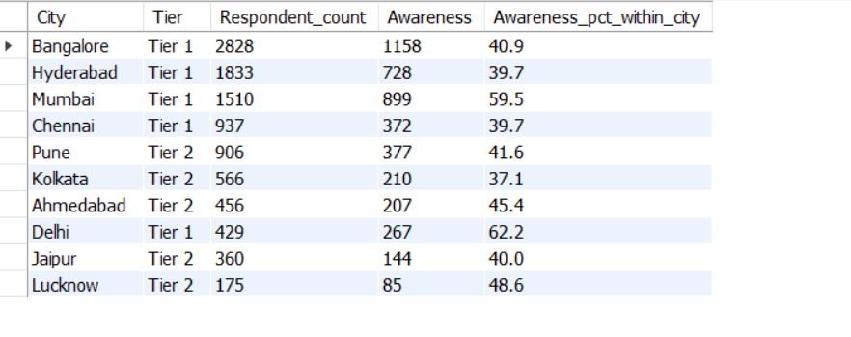
Which cities do we need to focus more on?
VISUALS
QUERY
OUTPUT

Slide 11
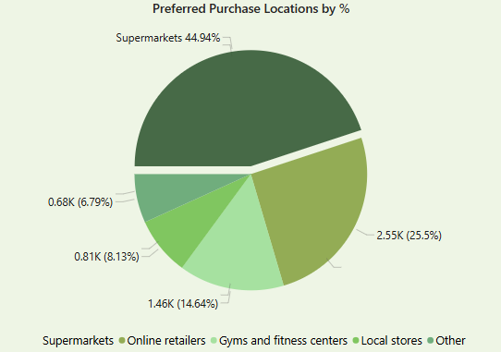
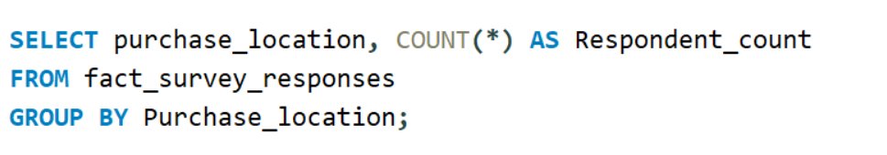
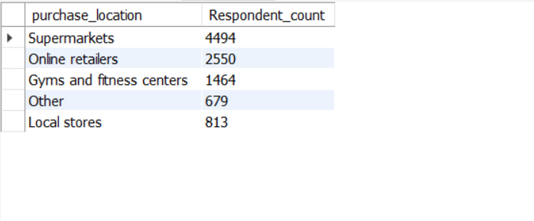
Where do respondents prefer to purchase energy drinks?
VISUAL
QUERY
OUTPUT

Slide 12
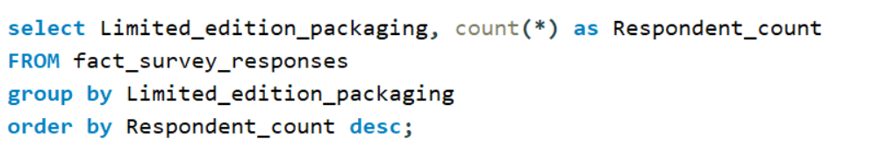
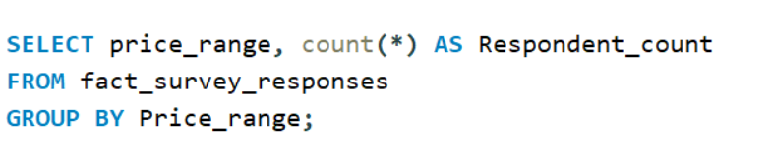
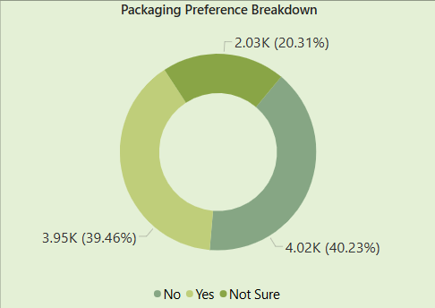
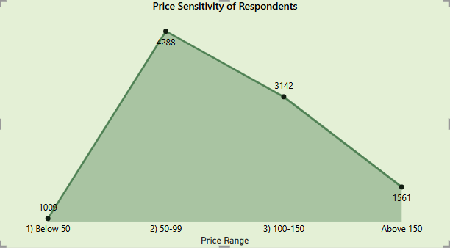
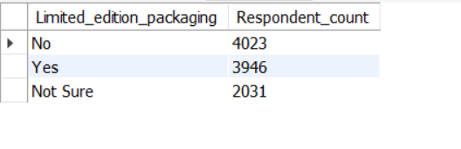
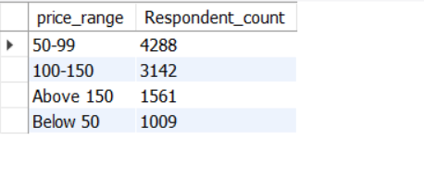
What factors influence respondents' purchase decisions, such as price range and limited-edition packaging?
VISUAL
QUERY
OUTPUT

Slide 13
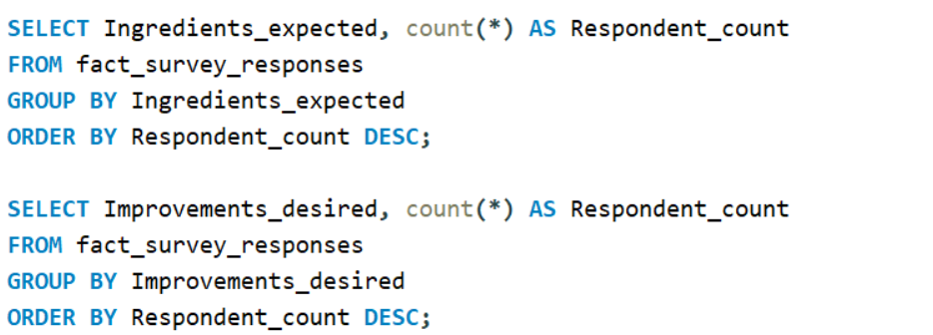
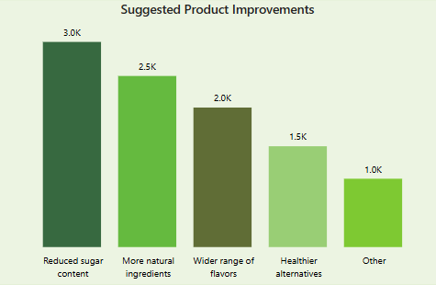
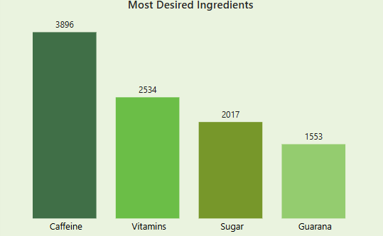
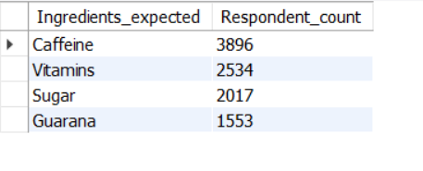
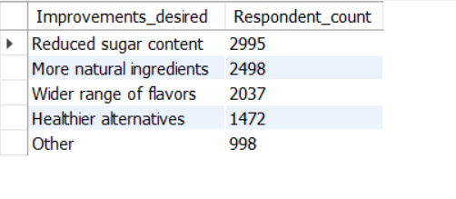
What immediate improvements can we bring to the product?
QUERY
OUTPUT
VISUAL

Slide 14
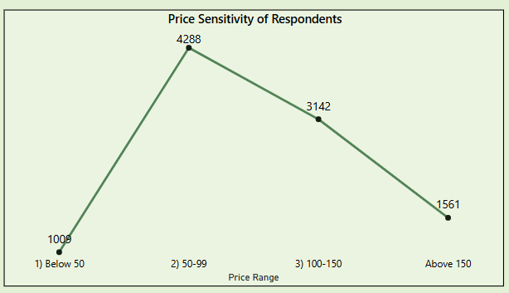
Ideal Price Range
INSIGHTS & RECOMMENDATIONS
What should be the ideal price of our product?
Mid-range dominance
Low interest in extremes

Slide 15
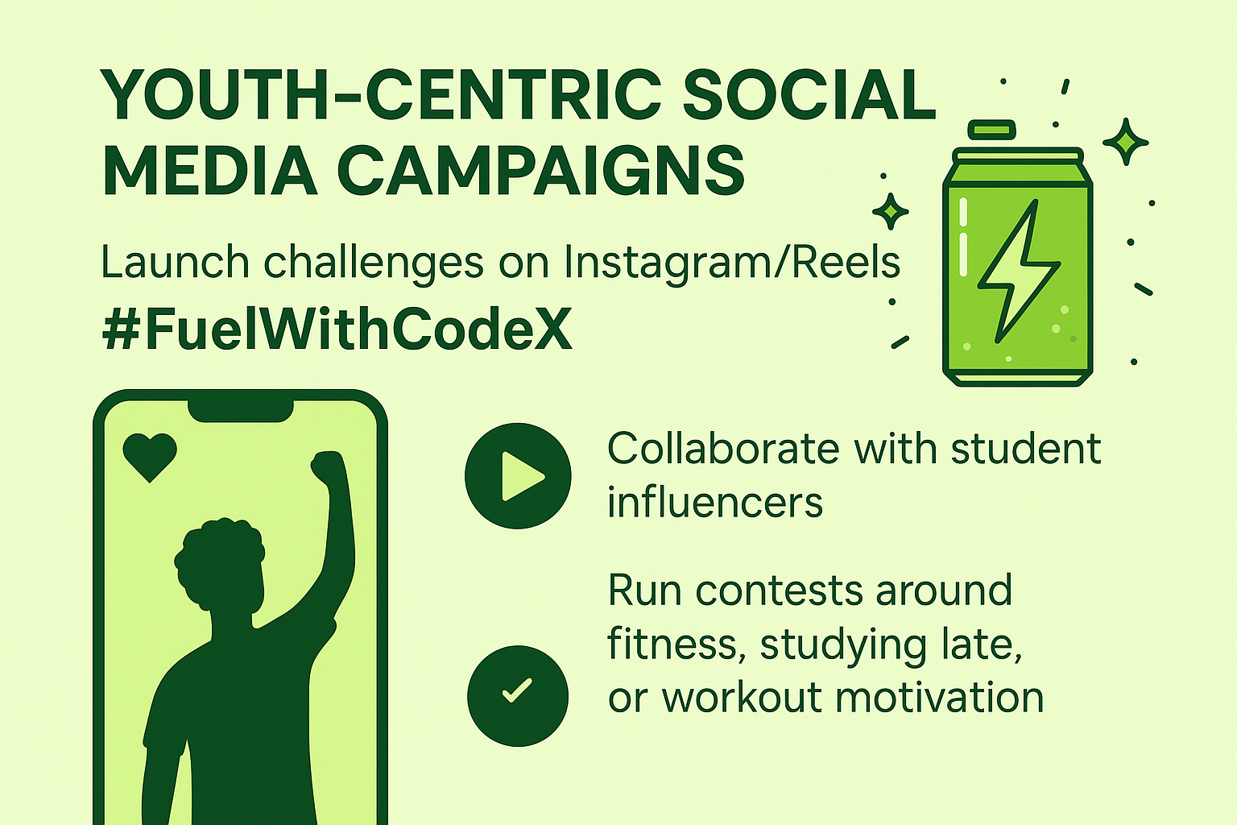

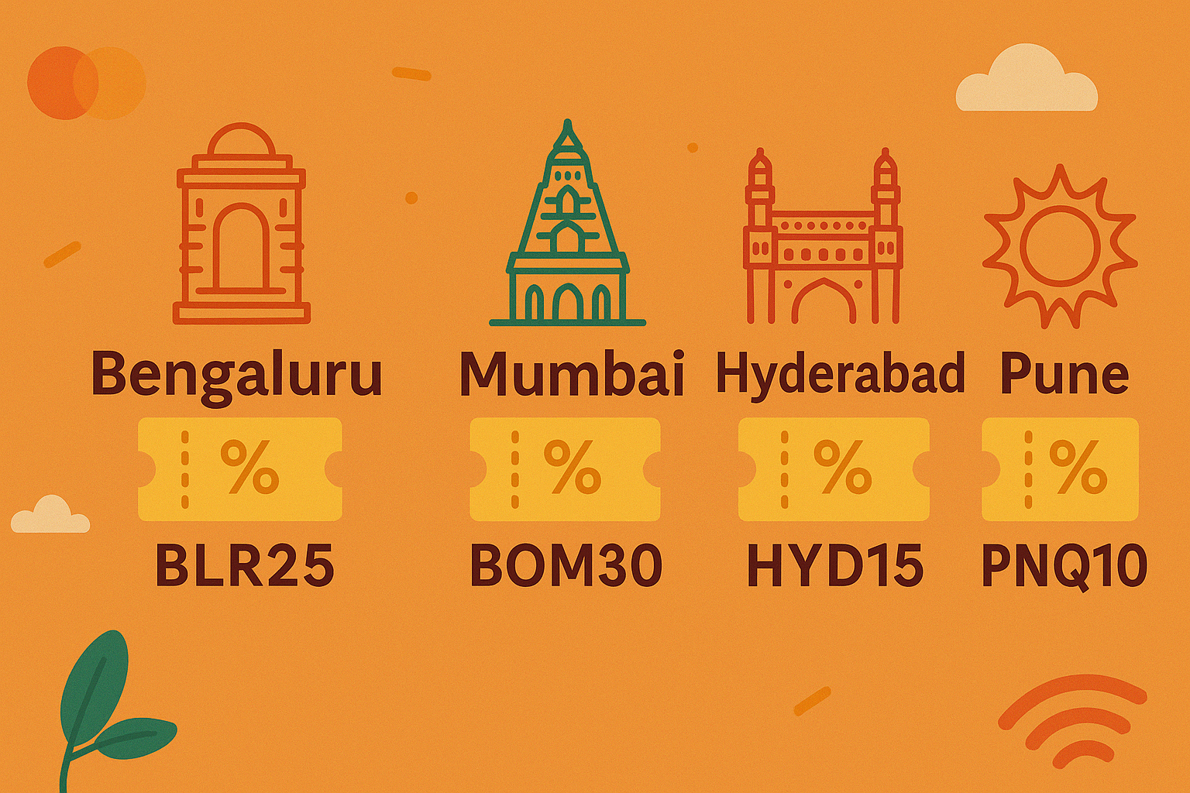
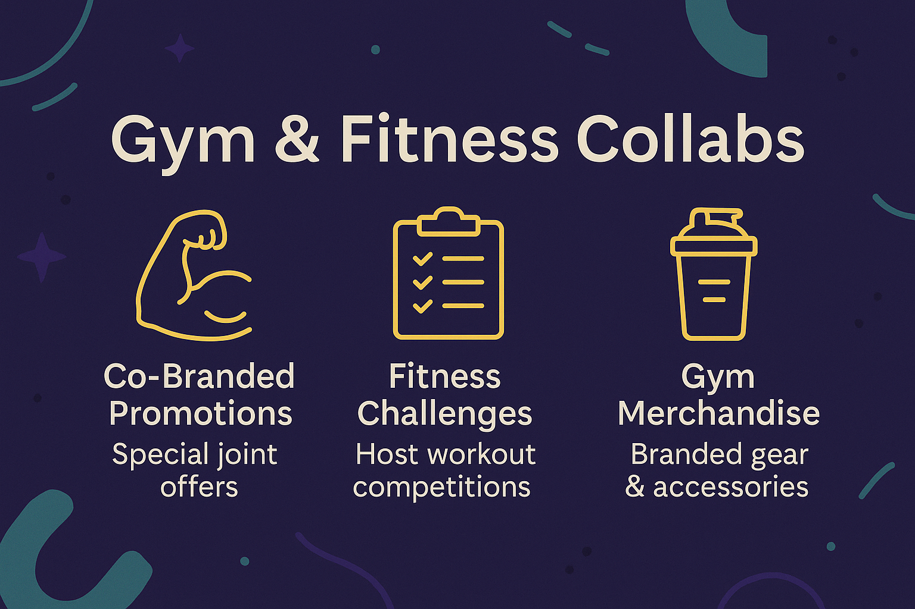
Marketing campaigns, offers, and discounts we can run
INSIGHTS & RECOMMENDATIONS
Youth-Centric Social Media Campaigns
Limited-Time Combo Offers (BOGO / Trial Packs)
City Specific Discounts
Gym & Fitness Collabs

Slide 16





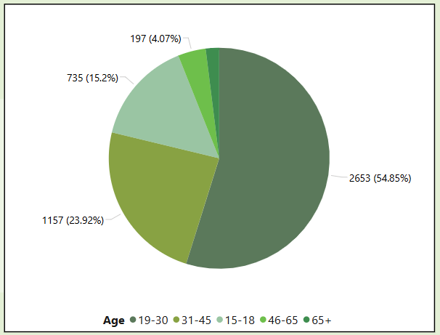


INSIGHTS & RECOMMENDATIONS
Target Audience
Geography
AGE - 19–30 years old
BENGALURU
MUMBAI
HYDERABAD
DELHI
CHENNAI

Slide 17
THANK YOU
https://github.com/moulika12k/CodeX-
https://app.powerbi.com/view?r=eyJrIjoiMWFkNGRlOTktYWRjNi00N2ZkLTlJjNCJ9

